Slide 1
Gesture Recognition
Rishabh Bhatt
Sanchal Thakkar
Megha Pujamath
Vinay Vemuri

Slide 2
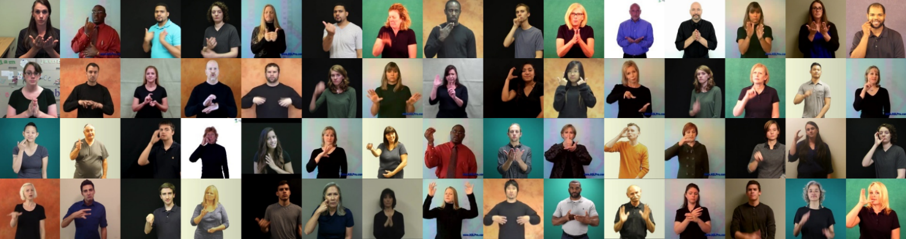
Problem Statement
Task identification : Given a video input the task is to detect and predict the sequence of signs and gestures that are performed and generate text/speech in natural language

Slide 3
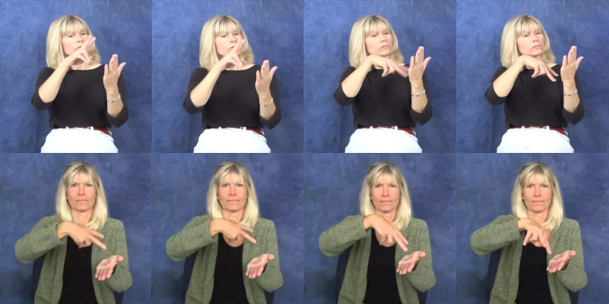
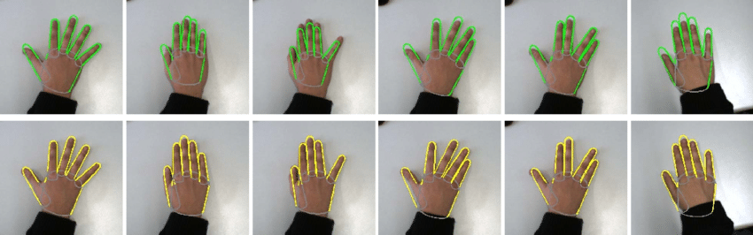
Why is it hard?
It is hard to detect the object of interest and isolate the ROI (Region of interest) in the wild
Sings are of two types - Static signs and Dynamic gestures
Sign languages have small, diverse and constantly evolving vocabulary

Slide 4
Related work
Word-level Deep Sign Language Recognition from Video: A New Large-scale Dataset and Methods Comparison
Transferring Cross-domain Knowledge for Video Sign Language Recognition
Real-time Hand Gesture Detection and Classification Using Convolutional Neural Networks
Make Skeleton-based Action Recognition Model Smaller, Faster and Better
TSPNet: Hierarchical Feature Learning via Temporal Semantic Pyramid for Sign Language Translation
Recognizing Surgical Activities with Recurrent Neural Networks

Slide 5
Datasets identified
WLASL : a largescale video dataset for Word-Level American Sign Language, containing more than 2000 words performed by over 100 signers.
SHREC : dataset contains 14 dynamic gestures performed by 28 participants (all participants are right-handed) and captured by the Intel RealSense short range depth camera. Each gesture is performed between 1 and 10 times by each participant in two way: using one finger and the whole hand
MS-ASL: A Large-Scale Data Set and Benchmark for Understanding American Sign Language by Microsoft, that covers over 200 signers, signer independent sets, challenging and unconstrained recording conditions and a large class count of 1000 signs.
How2sign

Slide 6
Project Workflow
Task identification - DONE
Dataset identification - DONE
Research and replicate results from previous work
Model creation and optimization - LSTM Model
Add customized pre-processing module
Compare Results
Deploy optimized model and pre-processing module to RT feed
Notes:
LSTM model
RNN

Slide 7
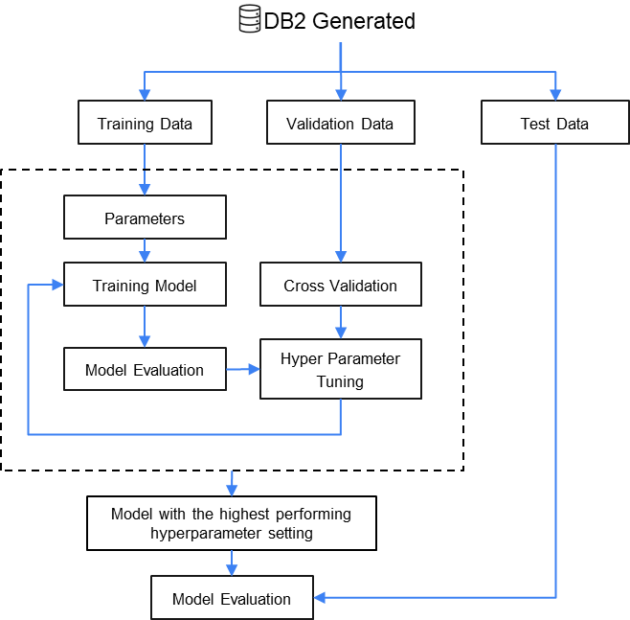

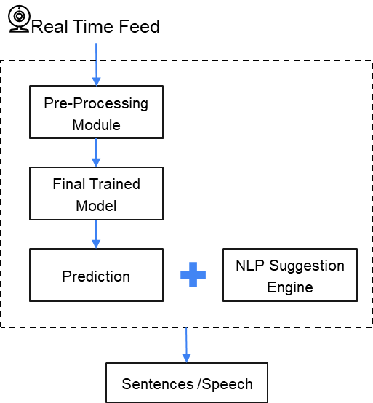
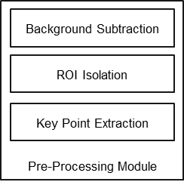
Pre-Processing
Model Development
Deployment
Raw Database
DB2 Generated
* LSTM Model

Slide 8
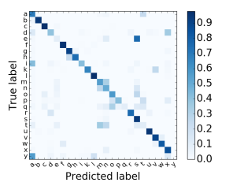
Evaluation metric(s)
Confusion Matrix
Precision
Recall
F1 Score
Fig. : Confusion Matrix for multi class classification

Slide 9
Thank You

Slide 10




Dataset
Real Time Feed
Pre-Processing Module
Background Subtraction
ROI Isolation
Pre-Processing Module
Key Point Extraction
Final Trained Model
Prediction
NLP Suggestion Engine
Sentences /Speech

Slide 11
DB2 Generated
Training Data
Validation Data
Test Data
Parameters
Training Model
Cross Validation
Model Evaluation
Hyper Parameter Tuning
Model with the highest performing hyperparameter setting
Model Evaluation

